Slide 1
Privacy-Preserving and Truthful Detection of Packet Dropping Attacks in Wireless Ad Hoc Networks

Slide 2
ABSTRACT:
To improve the detection accuracy, we propose to exploit the correlations between lost packets. Furthermore, to ensure truthful calculation of these correlations, we develop a homomorphic linear authenticator (HLA) based public auditing architecture that allows the detector to verify the truthfulness of the packet loss information reported by nodes.

Slide 3
EXISTING SYSTEM:
The most of the related works preclude the ambiguity of the environment by assuming that malicious dropping is the only source of packet loss, so that there is no need to account for the impact of link errors. On the other hand, for the small number of works that differentiate between link errors and malicious packet drops, their detection algorithms usually require the number of maliciously-dropped packets to be significantly higher than link errors, in order to achieve an acceptable detection accuracy.

Slide 4
DISADVANTAGES OF EXISTING SYSTEM:
In an open wireless environment, link errors are quite significant, and may not be significantly smaller than the packet dropping rate of the insider attacker. So, the insider attacker can camouflage under the background of harsh channel conditions. In this case, just by observing the packet loss rate is not enough to accurately identify the exact cause of a packet loss. This problem has not been well addressed in the existing system.
In the existing system first category case, the impact of link errors is ignored.

Slide 5
PROPOSED SYSTEM:
In this paper, we develop an accurate algorithm for detecting selective packet drops made by insider attackers.
Our algorithm also provides a truthful and publicly verifiable decision statistics as a proof to support the detection decision. The high detection accuracy is achieved by exploiting the correlations between the positions of lost packets, as calculated from the auto-correlation function (ACF) of the packet-loss bitmap—a bitmap describing the lost/received status of each packet in a sequence of consecutive packet transmissions.

Slide 6
ADVANTAGES OF PROPOSED SYSTEM:
The proposed system with new HLA construction is collusion-proof.
The proposed system gives the advantage of privacy-preserving.
Our construction incurs low communication and storage overheads at intermediate nodes. This makes our mechanism applicable to a wide range of wireless devices, including low-cost wireless sensors that have very limited bandwidth and memory capacities. This is also in sharp contrast to the typical storage-server scenario, where bandwidth/storage is not considered an issue.

Slide 7
BLOCK DIAGRAM:

Slide 8
HARDWARE REQUIREMENTS:
System : Pentium IV 2.4 GHz.
Hard Disk : 40 GB.
Floppy Drive : 1.44 Mb.
Monitor : 15 VGA Colour.
Mouse : Logitech.
Ram : 512 Mb.

Slide 9
SOFTWARE REQUIREMENTS:
Operating system : Windows XP/7.
Coding Language : JAVA
IDE : Netbeans 7.4

Slide 10
MODULES:
Network Configuration
Homomorphic Linear Authenticator
Setup Phase and Packet Transmission Phase
Audit Phase and Detection Phase

Slide 11
Network Configuration
In this project we are using Wireless Adhoc Network. Here we mainly focus on static or quasi-static network. In wireless network we need to send the packet through the node. System is represented as a node. Here every node has communication range. By using this range only we can transmit over packet. If source and destination node exists within the communication range, source can directly transmit the packet. Otherwise, we need to select the intermediate node based on the transmission range for transmit the packets.

Slide 12
Homomorphic Linear Authenticator
To correctly calculate the correlation between lost packets, it is critical to enforce a truthful packet-loss bitmap report by each node. We use HLA cryptographic primitive for this purpose. The basic idea of our method is as follows. An HLA scheme allows the source, which has knowledge of the HLA secret key, to generate HLA signatures s₁, . . , s_{M} for M independent messages r₁, . . . , r_{M}, respectively. The HLA signatures are made in such a way that they can be used as the basis to construct a valid HLA signature for any arbitrary linear combination of the messages, , without the use of the HLA secret key, where ci’s are randomly chosen coefficients.

Slide 13
Setup Phase and Packet Transmission Phase
This phase takes place right after route P_{SD} is established, but before any data packets are transmitted over the route. In this phase, S decides on a symmetric-key crypto-system (encrypt key, decrypt key) and K symmetric keys key1, . . . , key_{K}, where encrypt key and decrypt key are the keyed encryption and decryption functions, respectively. S securely distributes decrypt key and a symmetric key key_{j} to node nj on PSD, for j = 1, . . . ,K. Key distribution may be based on the public-key crypto-system such as RSA: S encrypts key_{j} using the public key of node n_{j} and sends the cipher text to n_{j} . n_{j} decrypts the cipher text using its private key to obtain key_{j} .

Slide 14
Audit Phase and Detecting Phase
This phase is triggered when the public auditor A_{d} receives an ADR message from S. The ADR message includes the id of the nodes on PSD, ordered in the downstream direction, i.e., n₁, . . . , n_{K}, S’s HLA public key information p_{k} = (v, g, u), the sequence numbers of the most recent M packets sent by S, and the sequence numbers of the subset of these M packets that were received by D. Recall that we assume the information sent by S and D is truthful, because detecting attacks is in their interest.

Slide 15
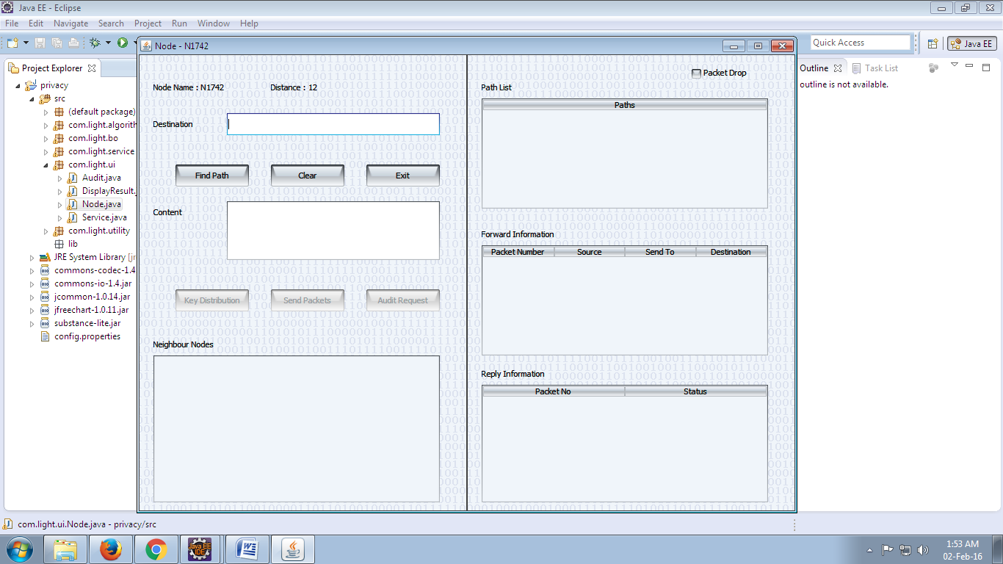

Slide 16
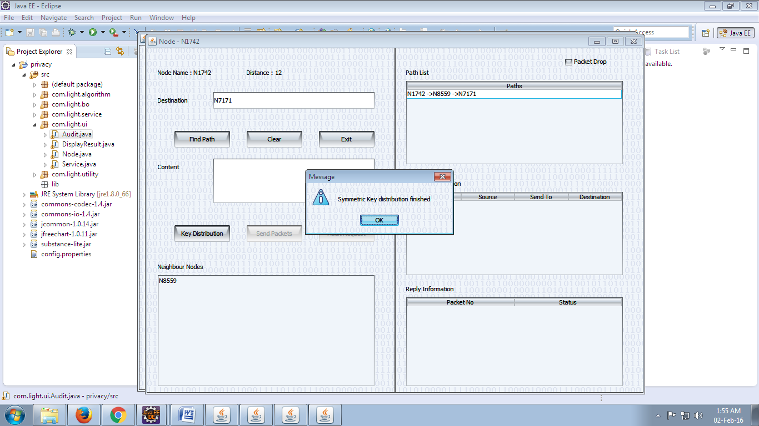

Slide 17
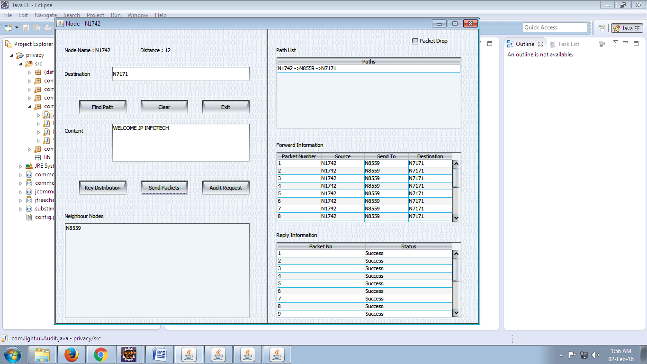

Slide 18
REFERENCE:
Tao Shu and Marwan Krunz, “Privacy-Preserving and Truthful Detection of Packet Dropping Attacks in Wireless Ad Hoc Networks”, IEEE TRANSACTIONS ON MOBILE COMPUTING, VOL. 14, NO. 4, APRIL 2015.

